Slide 1

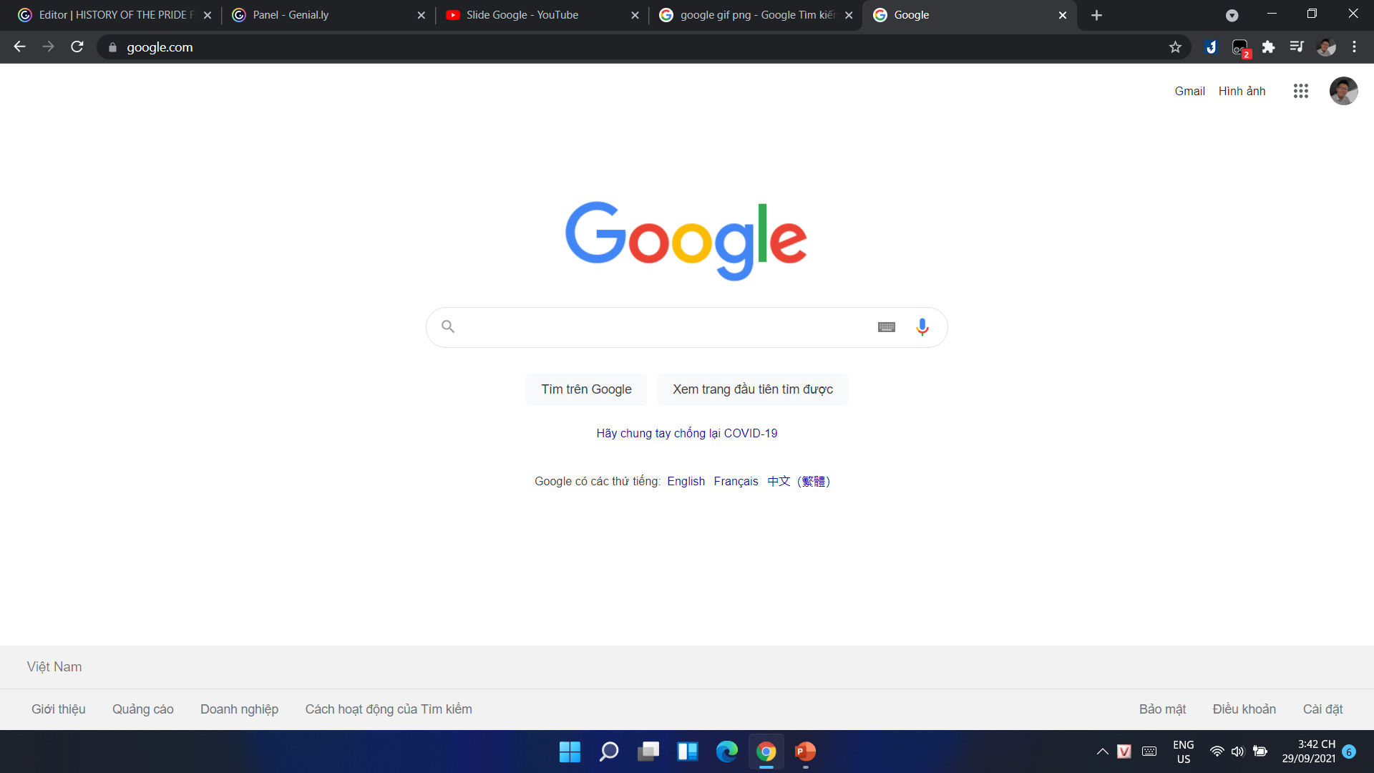

Team 16
Tìm kiếm Google
Xem Trang đầu tiên tìm được

Slide 2

Thành viên Trong nhóm
Môn học thuyết trình
Chủ đề thuyết trình
Bắt đầu thuyết trình
.
.
.
Welcome to Team 16

Slide 3






.
.
.
Welcome to Group Name
Team members
Topic
Contents
Presentation
Tên
Mã Sinh Viên
Tên
Mã Sinh Viên
Tên
Mã Sinh Viên
Tên
Mã Sinh Viên

Slide 4


Team members
Presentation
Chủ đề thuyết trình
Contents
Giáo viên bộ môn: Cô Nguyễn Văn A
Hoàng Gia Nguyên
Hoàng Long Vũ
20204889
20204897
Topic

Slide 5
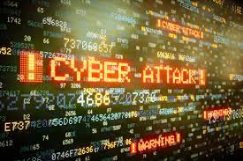
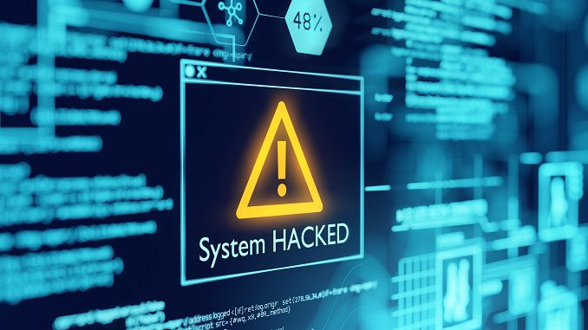
Topic
Presentation
Contents
Cyber attack
Tên
Tên
Tên
Tên
Mã Sinh Viên
Mã Sinh Viên
Mã Sinh Viên
Mã Sinh Viên
Team members
Thành viên Trong nhóm

Slide 6

Topic
Nội dung 1
Presentation
Nội dung 2
Cyber attack
Contents
Tên
Tên
Tên
Tên
Mã Sinh Viên
Mã Sinh Viên
Mã Sinh Viên
Mã Sinh Viên
Nội dung 3
Team members
Thành viên Trong nhóm
Nội dung 4

Slide 7

Contents
A brief history of Cyber Attacks
Presentation
Current trend of Cyber Attacks
Chủ đề thuyết trình
Tên
Tên
Tên
Tên
Topic
Types of Cyber Attacks
Mã Sinh Viên
Giáo viên bộ môn: Cô Nguyễn Văn A
Mã Sinh Viên
Mã Sinh Viên
Mã Sinh Viên
Team members
Thành viên Trong nhóm
How to protect against Cyber Attacks

Slide 8
Nội dung 1
Contents
Nội dung 2
Let’s start the presentation
Chủ đề thuyết trình
Tên
Tên
Tên
Tên
Topic
Mã Sinh Viên
Nội dung 3
Giáo viên bộ môn: Cô Nguyễn Văn A
Mã Sinh Viên
Mã Sinh Viên
Mã Sinh Viên
Team members
Thành viên Trong nhóm
Nội dung 4

Slide 9
Contents
1.Why cyber attacks?
A brief history
Topic
Team members

Slide 10
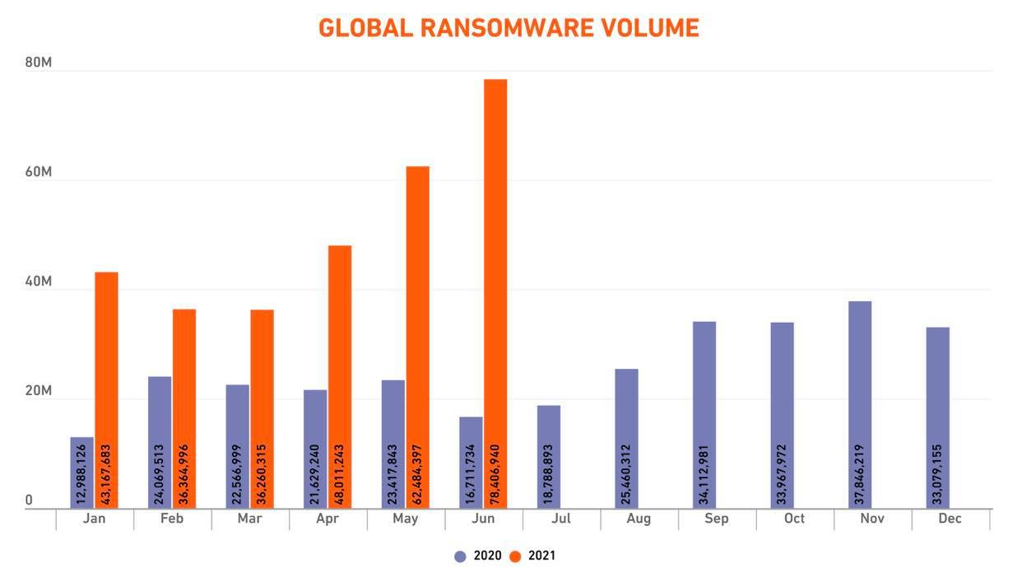
Why cyber attack ?
+) The dramatic surge of cyber attacks in recent years -> everyone should be highly aware of cyber attacks.
+) Let’s have a look at the statistics of the total ransomware attempt volume in 2020 compared to 2021 (by SonicWall):

Slide 11
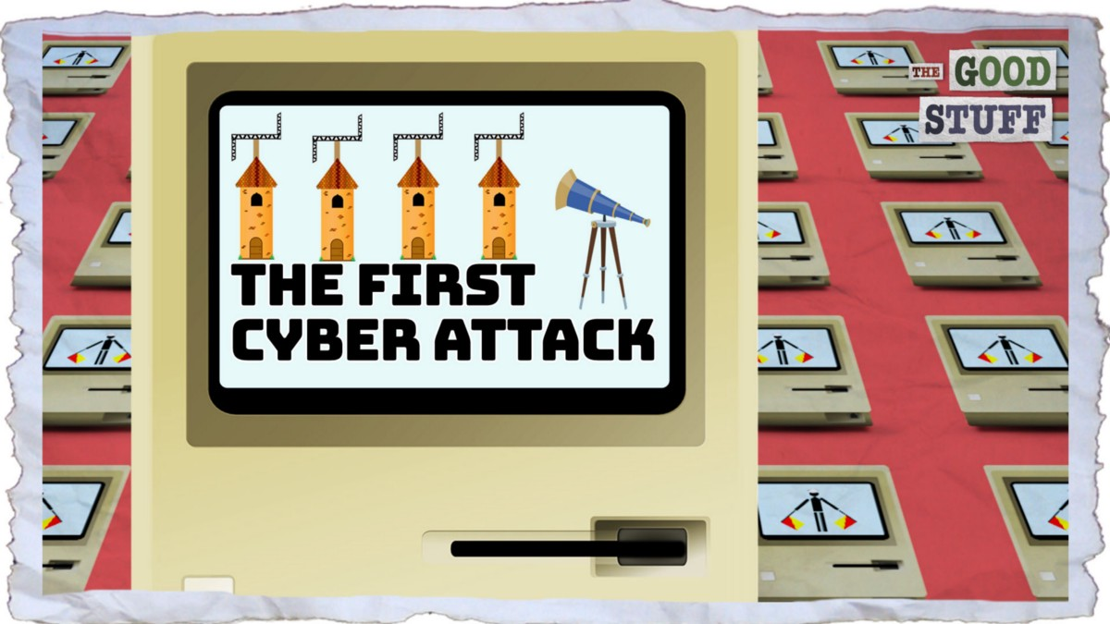
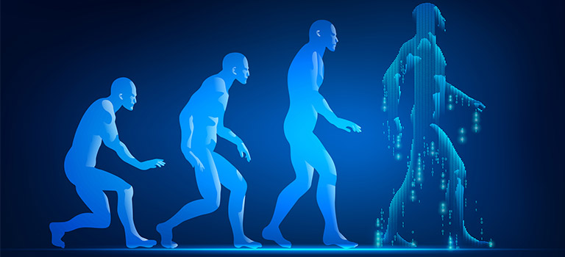
A brief history of cyber attack
First Cyber Attack
November 1988
Created by a graduate student Robert Morris
A program that would travel from computer to computer and ask machine to send a signal back
- First Distributed Denial of Service (DDoS)

Slide 12
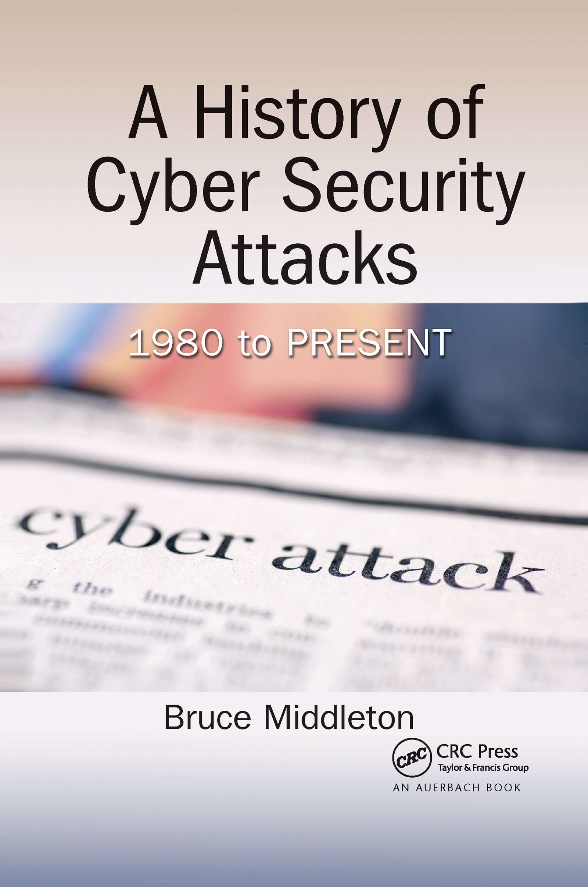
A brief history of cyber attack
2. Some notorious cyber attacks:
WannaCry (2017):
+) knocked out more than 200,000 computers in 150 countries in 4 days
+) $8B in total
+) ransomware
NotPetya/ExPetr:
+) one of the costliest cyber attacks
+) around $10B
+) another ransomware encryptor

Slide 13
Contents
2.Current Trend of Cyber Attacks
Topic
Team members

Slide 14
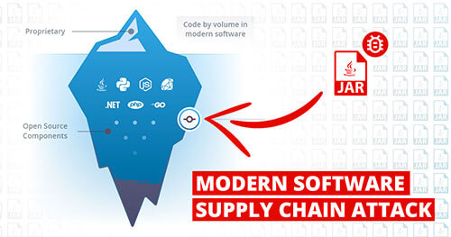

Current Trend of Cyber Attacks
1.Software supply chain attacks:
- Increase by four-fold in the remainder of 2021
- Install malicious code into legitimate software
2. Phishing cyber attacks
- Most common type of cybercrime
- 96% are done by email
The goal is to trick the email recipient into believing that the message is something they want or need

Slide 15
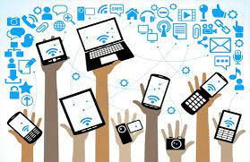
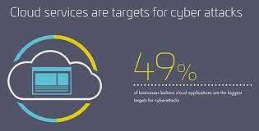
Current Trend of Cyber Attacks
3. Clouds
Any cyber attacks that target off-site service
Cloud computing involves the use of shared technologies
Attackers can cause significant damage to many cloud users
Misconfiguration and poor management of cloud resources
4. Mobile device attacks
In 2020, CheckPoint found a 15% increase in banking Trojan activity
Threat actors have been spreading mobile
- Hiding the malware in apps that claim to offer COVID-19 information

Slide 16
Current Trend of Cyber Attacks
5. Rise of ransomware
- Every week, more than 1200 organizations worldwide fall victim to a ransomware attack, and all enterprises are at risk

Slide 17

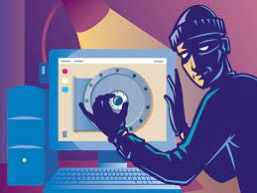
Current Trend of Cyber Attacks
6. IoT
Dan Demeter, security expert at Kaspersky:
“We see that once users’ interest in smart devices rose, attacks also intensified.”
IoT security hacks can happen in anywhere and in any industry, from a smart home
The severity of impact depends great greatly on the individual system, the data collected and/or the information it contains
Thanks For Watching!

Slide 18
Chủ đề thuyết trình
3. Some types of Cyber Attacks
Môn học thuyết trình
Thành viên Trong nhóm

Slide 19
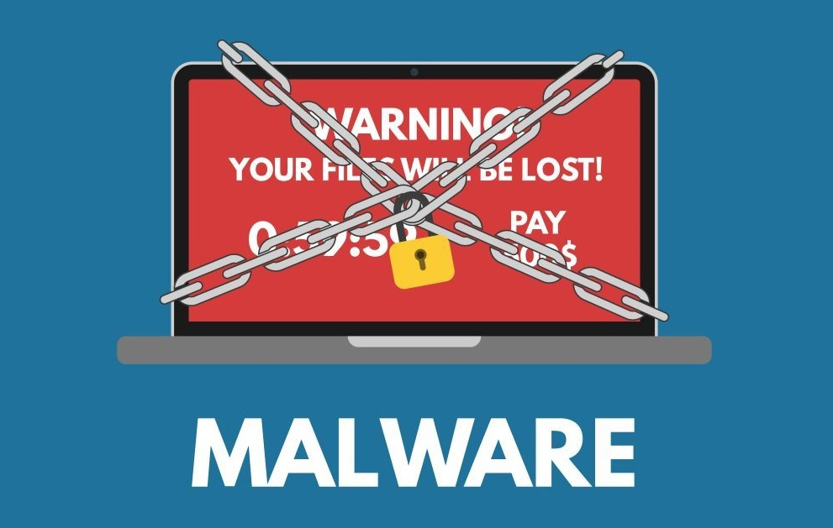
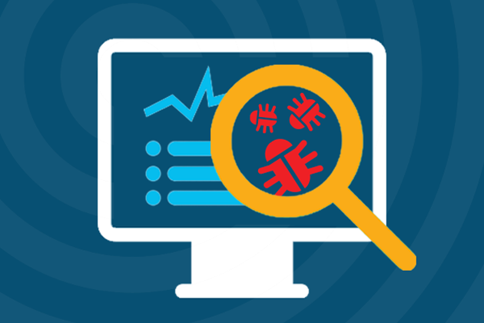
Some Types Of Cyber Attacks
1. Malware
- A malware attack is a common cyberattack
Restrict access to important files, slow down the computer
Can be sent via email, flash drive
Types of malware:
+) Trojan
+) Spyware (steal info)
+) Adware (display disturbing ads)
+) Ransomware

Slide 20
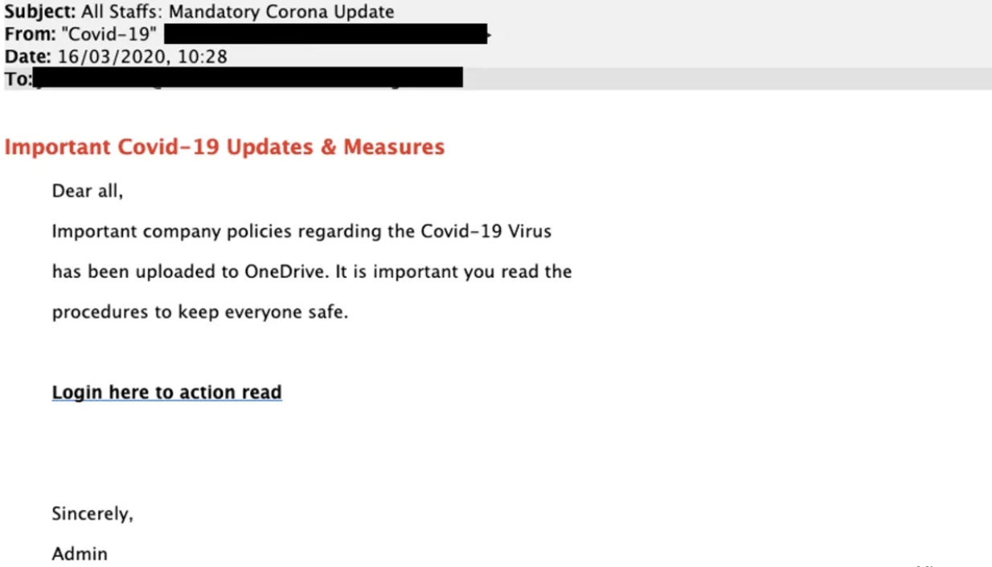
Some Types Of Cyber Attacks
2. Phishing
Phishing use disguised email as a weapon.
The goal is to trick the email recipient
Types of phishing:
+) Spear phishing
+) Whaling
In 2016, an employee at Snapchat disclosed all of the company’s payroll data to a scammer

Slide 21
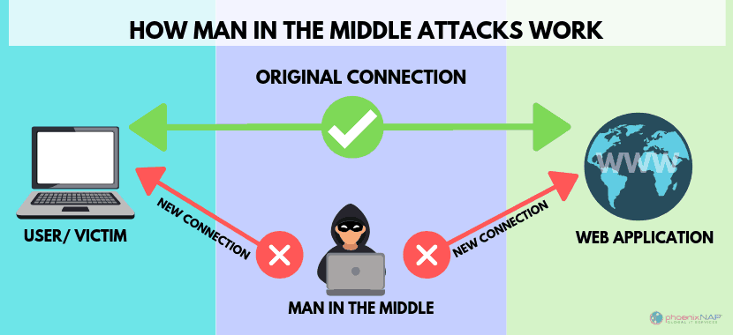
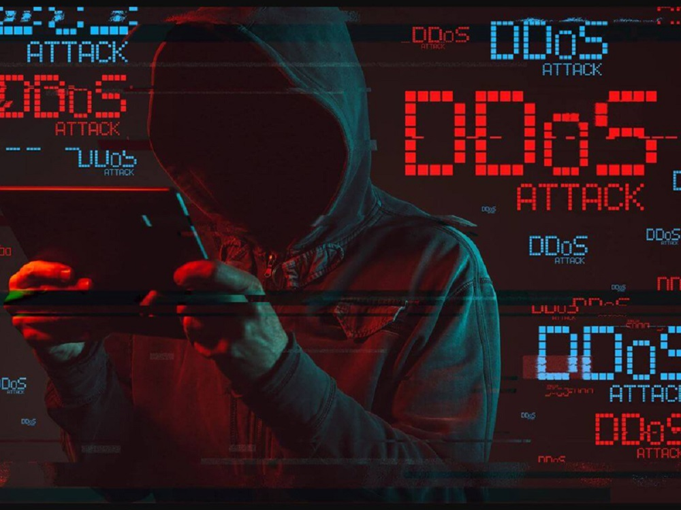
Some Types Of Cyber Attacks
3. Man-in-the-middle (MitM)
The attacker intercepts the communication
WFH in COVID has made this surge again
- Popular: Wi-Fi networks in public places (coffee shops)
4. DDoS
Distributed Denial of Service attack
Takes advantage of the capacity limits applied to the network resources

Slide 22
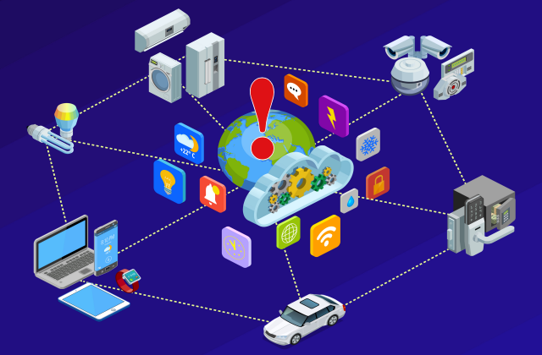
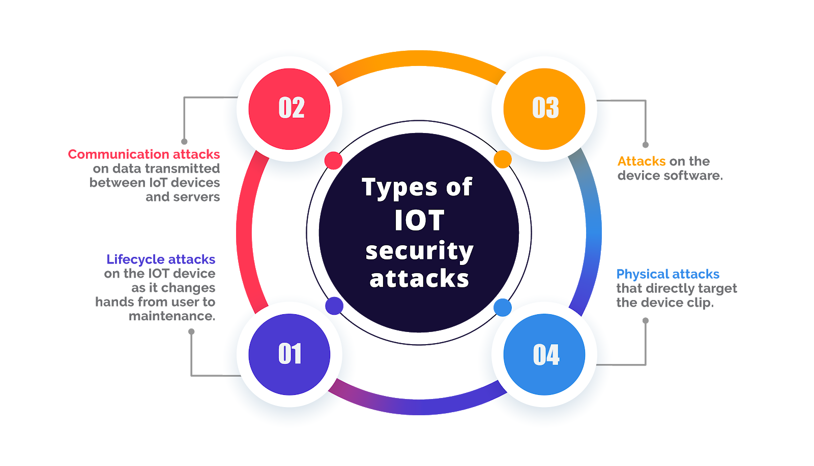
Some Types Of Cyber Attacks
5. IoT
Seek to gain access to IoT devices
Reasons for increasing of IoT attacks: COVID 19, internet visibility
Four main types
Thanks For Watching!

Slide 23
Chủ đề thuyết trình
4. How to protect against Cyber Attacks?
Môn học thuyết trình
Thành viên Trong nhóm

Slide 24
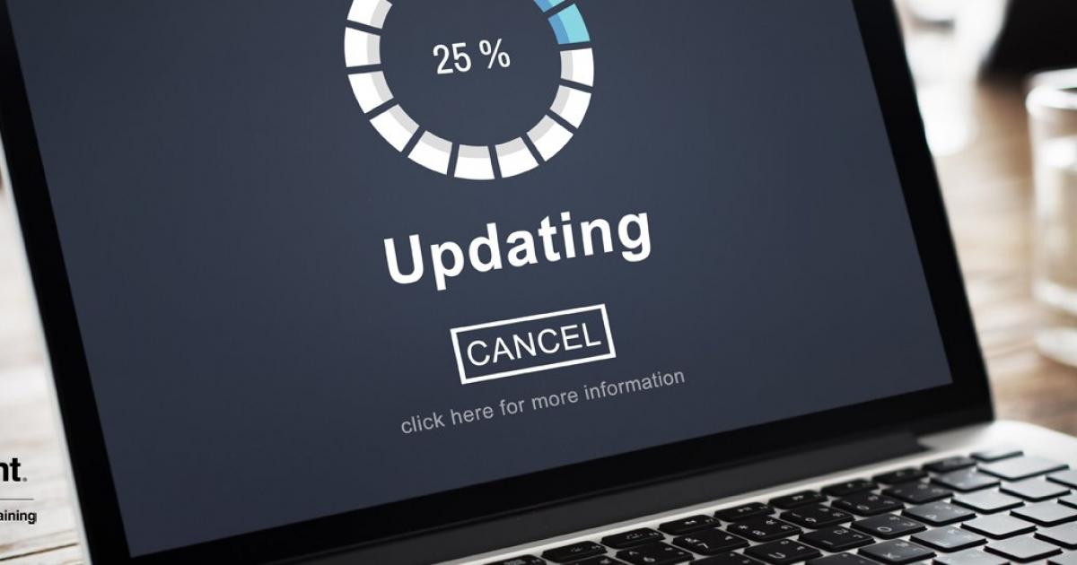
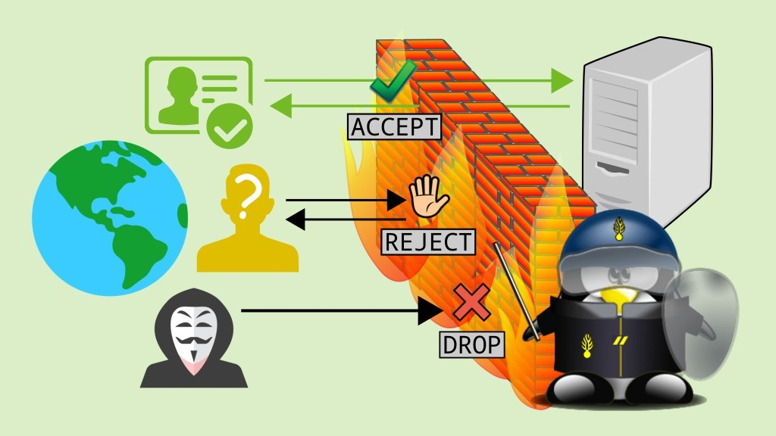
How To Protect Against Cyber Attacks
1. Keep your software updated:
Reduce vulnerabilities
Have the latest patches
Use auto update
2. Install a firewall:
Stands between user and server
Block some types of cyber attacks
Prevent DDOS attacks

Slide 25
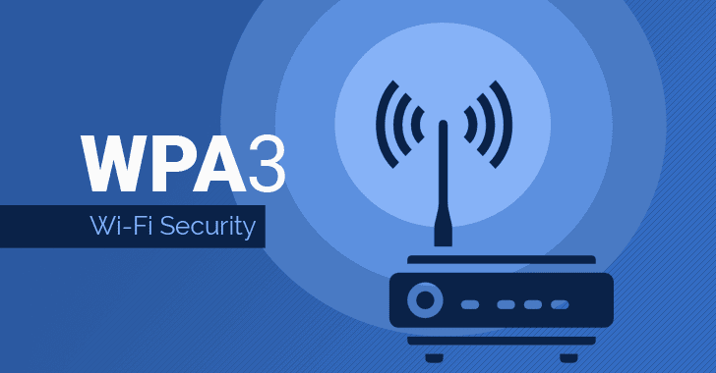
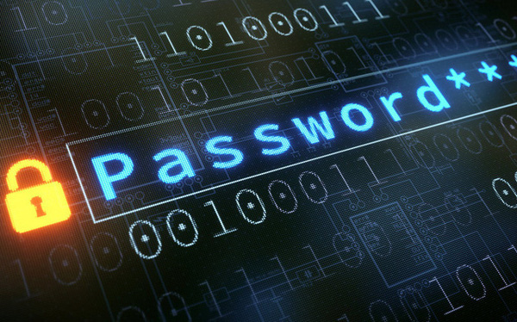
How To Protect Against Cyber Attacks
3. Wi-Fi security:
Prevent MiTM attacks
Using VPN to encrypt your connection
4. Updated password
Avoid using same password for many things
Consider using hard passwords
Change your password periodically
5. Backup data
Have hope though all your data is lost
Enable auto backup

Slide 26
Nội dung 1
Nội dung 4
Nội dung 2
Nội dung 3
Thanks For Listening!

